Slide 1
models

Slide 2
Robotic systems
The research focus is in the development of new technologies for robotic systems including the following fields:
development of advanced control strategies for robots (including modeling and simulation)
low level reflexive control, compliancy and redundancy
physical interaction with humans and the environment
transfer and generalization of interactive skills from human to robot
cooperating robot systems
robot motion synthesis through learning
sensory systems (vision, force)
automation of industrial processes

Slide 3
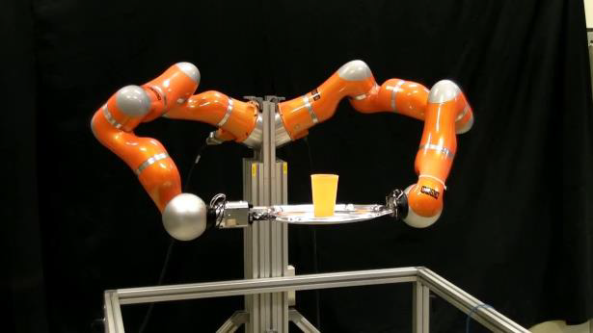
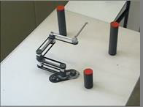
Robotic systems

Slide 4
The role of simulation
Simulation allows us to study the structure, characteristics and the function of a system at different levels of details each posing different requirements for the simulation tools. As the complexity of the system under investigation increases the role of the simulation becomes more and more important.
The simulation tools can certainly enhance design, development and operation of robotic systems.
Augmenting the simulation with visualization tools and interfaces, one can simulate the operation of the robotic systems in a very realistic way.

Slide 5
Requirements for the simulation environment
Simulation tools for robotic systems differ depending on which aspect of the robot research they support. In most simulation tools the focus is on the motion of the robot manipulator in different environments.
Requirements for use in research and teaching:
openness(easy access to the system, open architecture, easy integration of modules)
reconfigurability(quick modifications and verification of effects)
ease of use (many users, different expertise, easy testing on real robots, hidden implementation details, unified tools and environment)
Augmenting the simulation with visualization tools and interfaces, one can simulate the operation of the robotic systems in a very realistic way.

Slide 6
Planar Manipulators Toolbox
The Planar Manipulators Toolbox is based on a kinematic and dynamic model of a planar manipulator with revolute joints.
PMT consists of several M-files for the calculation of the model and other functions for planar manipulators which can not be created using the standard ones.
The user has to write only some model specific functions.
PMT enables the real-time simulation and the online robot control, i.e. Manipulator in the loop simulation, using MATLAB functions and Simulink blocks.
For the use with Real-Time Workshop main functions have been rewritten into C MEXS-functions versions.

Slide 7
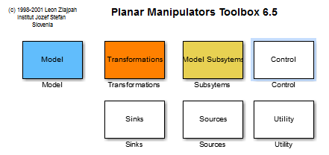
Planar Manipulators Toolbox

Slide 8
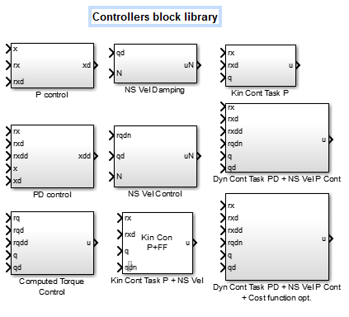
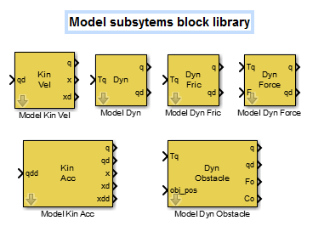
Planar manipulator toolbox

Slide 9
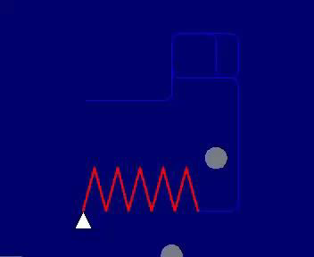
Obstacle avoidance

Slide 10
Simulink blocks
A new MATLAB/Simulink based integrated environment for the simulation and for the control design for more general robot systems.
A crucial feature for development of robot control systems is that the user can easy switch between using model or a real system in the simulation loop.

Slide 11
Simulink blocks
To simulate the kinematics and dynamics of arbitrary chosen kinematic chain describing different manipulators,
To enable integration of different sensor systems like vision and force sensors,
To enable simulation of scenarios for complex robot tasks,
To include the model the robots' environments,
To visualize the robots and their environment,
To enable integration of real robots in the simulation loop and to allow distributed computation over more computers.

Slide 12
Simulink blocks

Slide 13
Simulink blocks

Slide 14
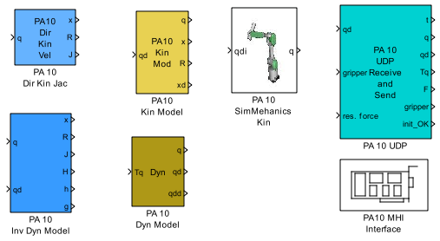
Robot model
For each robot we need:
Kinematic models
Dynamic models
Interfaces
Special control blocks

Slide 15
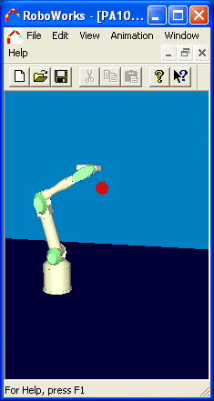
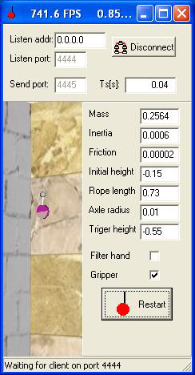
Robot playing Yo-yo: Control strategy
Design and test different control strategies
Model of yo-yo in Simulink
Simple robot model

Slide 16
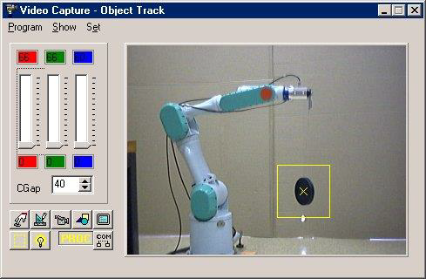
Robot playing Yo-yo: Control strategy
Testing on a real robot:
The position of the yo-yo is now obtained from the vision system
Force sensor is used to measure string forces

Slide 17
Joining robot arms
There are many tasks that can be performed in cooperation, i.e. using multi-arm robots.
We provide blocks for joining robot arms, i.e. a model of a complete robot system consists of a models of particular robot arm models which are connected using special Simulink blocks.

Slide 18
Joining robot arms
There are many tasks that can be performed in cooperation, i.e. using multi-arm robots.
We provide blocks for joining robot arms, i.e. a model of a complete robot system consists of models of particular robot arm models which are connected using special Simulink blocks.

